Slide 1


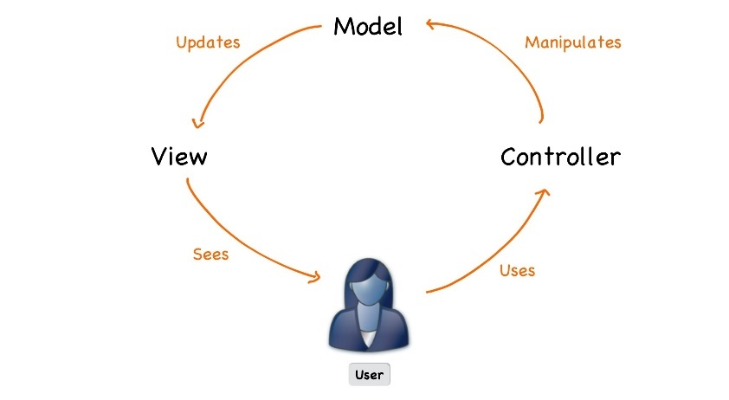



PHP Web Development Basics
Course Overview
Web Development Basics
SoftUni Team
Technical Trainers
Software University
http://softuni.bg

Slide 2








Table of Contents

Slide 3
Have a Question?
sli.do #PHP-Web

Slide 4







SoftUni Diamond Partners

Slide 5




PHP Web Development Basics
Course Objectives & Program

Slide 6
Course Objectives
The PHP Web Dev Basics course provides
Basic knowledge over HTML and CSS
Fundamental knowledge over what is HTTP and how it works
Fundamental knowledge over what is a database and how it works
Fundamental knowledge for creating web applications

Slide 7

The Trainers Team

Slide 8
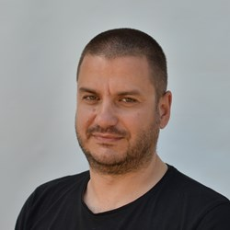
Trainers Team
Veselin Malezanov
Trainer @ Software University
20+ years of experience with PHP
Takes an active role in the development of www.abv.bg

Slide 9

Trainers Team
Boyan Mihailov
Trainer @ Software University
Web Developer @ Design Force LTD.
12 years of experience with PHP and web development
Specialized in real-estate web applications

Slide 10

Trainers Team
Angel Miladinov
Top Performing Student @ Software University
PHP Web Developer @ WebAnD

Slide 11

Evaluation

Slide 12


Scoring System for the Course
Mandatory:
Final exam – 90%
Homework submissions – 10%
Bonuses:
Presence in class – 5% bonus
Forum activity – bonus up to 5%

Slide 13

The Final Exam
Solving simple HTML & CSS problems
Solving simple MySQL problems
Creating web application

Slide 14










Resources
What We Need Additionally?

Slide 15



PHP Course Web Site, Forum and FB Group
Official web site:
Official discussion forum:
Official Facebook groups:
https://softuni.bg/courses/php-basics
https://softuni.bg/forum/categories/10/php-web-development-basics
https://www.facebook.com/groups/phpweb

Slide 16

The PHP Web Dev Basics Slides and Videos
All lecture slides, videos, homework assignments, projects and other resources are open content, available for free
Visit the course web site to access the course resources

Slide 17



PHP Recommended Software
Software needed for this course:
Microsoft Windows 10 / Linux / Mac OS
PhpStorm – https://www.jetbrains.com/phpstorm/
Heidi SQL - https://www.heidisql.com/
XAMPP - https://www.apachefriends.org/index.html

Slide 18



Learn to Search in Internet
The course assignments require to search in Internet
This is an important part of the learning process
Some exercises intentionally have no hints
Learn to find solutions!
Software development includes everyday searching and learning
No excuses, just learn to study!
Developers learn new technologies, tools, languages every day!

Slide 19
PHP Web Development Basics – Course Overview
https://softuni.bg/courses/php-basics

Slide 20
License
This course (slides, examples, demos, videos, homework, etc.) is licensed under the "Creative Commons Attribution-NonCommercial-ShareAlike 4.0 International" license

Slide 21





Trainings @ Software University (SoftUni)
Software University – High-Quality Education, Profession and Job for Software Developers
softuni.bg
Software University Foundation
http://softuni.foundation/
Software University @ Facebook
facebook.com/SoftwareUniversity
Software University Forums
forum.softuni.bg

